Slide 1
Busitema
University
Pursuing excellence
Faculty of Engineering and Technology
Group 17
MATLAB Group Assignment

Slide 2
Busitema
University
Pursuing excellence
Group 17 Members
Name | Reg Number | Program
AHAISIBWE CHRISTOPHER | BU/UP/2024/0824 | AMI
GIFT EMMANUEL | BU/X/2024/3250 | WAR
ADWONG CALEB | BU/UP/2024/3813 | MEB
MUWUBYA WYCLIFFE | BU/UP/2024/1045 | WAR
OWINO POSH | BU/UP/2024/1067 | WAR
ATATI EDWINE | BU/UP/2024/3730 | AMI
NABUKEERA ANNET RIONAH | BU/UG/2024/2676 | AMI
AHEREZA FAITH | BU/UG/2024/2673 | APE
OPOKA VINCENT | BU/UG/2024/2675 | AMI
AKELLO BARBRA | BU/UP/2024/1001 | WAR

Slide 3

CHAPTER ONE
Problem statement
Accurate prediction of crop yield is a challenge in modern agriculture. Traditional methods often rely on manual observations or historical averages, which are prone to errors and cannot efficiently account for the dynamic effects of climatic conditions, soil quality, and agricultural practices. The inability to accurately predict yields can lead to inefficient resource allocation, economic losses, and food insecurity. Therefore, there is a need for a reliable, data-driven system that can analyze multiple factors affecting crop productivity and provide precise yield predictions in a timely manner.
Group 17

Slide 4
Objectives:
To collect and preprocess relevant agricultural data, including soil characteristics, rainfall, temperature, and fertilizer usage.
To implement feature extraction and data analysis techniques using MATLAB for identifying key factors influencing crop yield.
To design and test predictive models using statistical and machine learning approaches for accurate yield estimation.
To evaluate the performance of the developed system and compare predicted yields with historical data.
To provide recommendations for precision agriculture practices based on the findings.
:
Group 17

Slide 5
CHAPTER TWO: METHODOLOGY
At the beginning a meeting was held with all group members and discussed away forward. One of our group members went ahead to explain to us and teach us how we can develop the codes using matlab. Another meeting was held where the codes were developed.
Group 17

Slide 6
CROP MODEL
It serves as a template for all crop yield estimation models and demonstrates OOP principles such as abstraction, encapsulation and polymorphism
classdef (Abstract) CropModel
% CROPMODEL: Abstract base class for all crop yield estimation models.
properties (SetAccess = private)
CropType % Name of the crop the model is trained for.
end
Group 17

Slide 7
properties (Access = protected)
% Protected property for internal model structure (Encapsulation).
ModelStructure
end
methods
function obj = CropModel(cropType)
% Constructor
obj.CropType = cropType;
end
function displaySummary(obj)
% Standard method to display model details.
Group 17

Slide 8
disp(['Model Type: ', class(obj)]);
disp(['Crop: ', obj.CropType]);
end
end
methods (Abstract)
% Abstraction & Polymorphism: Methods must be implemented by concrete subclasses.
% Abstract method: Trains the model on features X and target Y.
obj = trainModel(obj, X, Y)
% Abstract method: Predicts yield for new features X_new.
predictedYield = predictYield(obj, X_new)
end
end
Group 17

Slide 9
LINEAR REGRESSION CROP MODEL
It extends the abstract crop model to implement a linear regression-based crop yield estimation model and demonstrates key OOP concepts such as inheritance, polymorphism, encapsulation, abstraction, and method overriding. It provides a ready-to-use linear regression model for estimating crop yields, enforces consistent interface from crop model, making it easy to integrate with other crop models and allows training, prediction, and inspection of the model in a structured, maintainable way.
classdef LinearRegressionCropModel < CropModel
% LINEARREGRESSIONCROPMODEL: A concrete yield model using linear regression.
properties
Coefficients % Model coefficients (Encapsulation)
Rsquared % R-squared value
end
methods
function obj = LinearRegressionCropModel(cropType)
% Calls the superclass constructor (Inheritance)
obj = obj@CropModel(cropType);
end
Group 17

Slide 10
function obj = trainModel(obj, X, Y)
% Polymorphism: Concrete implementation of trainModel for Linear Regression.
disp(['Training Linear Regression Model for ', obj.CropType, '...']);
% FIX: Combine the feature table (X) and response vector (Y) into a single table (T).
% This preserves the predictor column names for the model structure.
T = [X, table(Y, 'VariableNames', {'TargetYield'})];
% Matlab's fitlm function: Use the specified formula with named variables.
LM = fitlm(T, 'TargetYield ~ average_rain_fall_mm_per_year + pesticides_tonnes + avg_temp');
Group 17

Slide 11
% Store results in the inherited/own properties (Encapsulation)
obj.ModelStructure = LM;
obj.Coefficients = LM.Coefficients.Estimate;
obj.Rsquared = LM.Rsquared.Ordinary;
disp('Training complete.');
end
function predictedYield = predictYield(obj, X_new)
% Polymorphism: Concrete implementation of predictYield.
if isempty(obj.ModelStructure)
error('LinearRegressionCropModel:NotTrained', 'Model must be trained first.');
end
Group 17

Slide 12
% X_new is already a table with the correct column names,
% which now match the names stored in obj.ModelStructure.
predictedYield = predict(obj.ModelStructure, X_new);
end
function displaySummary(obj)
% Overriding and extending the inherited displaySummary method.
displaySummary@CropModel(obj); % Call parent method (Inheritance)
disp(' Model Statistics ');
disp(['R-squared: ', num2str(obj.Rsquared)]);
disp('Coefficients (Intercept, Rainfall, Pesticides, Temperature):');
disp(obj.Coefficients');
end
end
end
Group 17

Slide 13
SIMULATION
It performs a complete crop yield estimation workflow using object-oriented programming principles.
% High-level simulation script for Crop Yield Estimation
clear
clc
% 1. Data Initialization and Preprocessing (Encapsulation)
dataManager = YieldData('yield_df.csv');
dataManager = dataManager.preprocessData();
% 2. Select Crop and Get Filtered Data
targetCrop = 'Wheat';
Group 17

Slide 14
% FIX: Use the public method to filter the data, respecting Encapsulation.
[X_crop, Y_crop] = dataManager.filterDataByCrop(targetCrop);
% Visualizes the raw relationship between features and the target yield
figure('Name', 'Feature Relationships');
FeatureCols = X_crop.Properties.VariableNames;
% Loop through all three features and plot against the yield (Y_crop)
for i = 1:length(FeatureCols)
subplot(1, 3, i); % 1 row, 3 columns of plots
scatter(X_crop{:, i}, Y_crop, 15, 'filled', 'MarkerFaceAlpha', 0.5);
% Clean up variable names for titles/labels
readableName = strrep(FeatureCols{i}, '_', ' ');
title(['Yield vs. ', readableName]);
xlabel(readableName);
Group 17

Slide 15
ylabel('Predicted Yield (hg/ha)');
legend('Test Predictions', 'Ideal Fit', 'Location', 'best');
grid on;
saveas(gcf,'y=x line.png');
% 3. Residuals Plot (New)
Residuals = Y_actual - Y_predicted;
figure('Name', 'Residuals Plot');
scatter(Y_predicted, Residuals, 50, 'filled', 'MarkerFaceAlpha', 0.6);
hold on;
saveas(gcf,'Residuals plot.png');
Group 17

Slide 16
% Plot the y=0 line
plot(xlim, [0 0], 'k--');
title(['Residuals Plot for ', targetCrop]);
xlabel('Predicted Yield (hg/ha)');
ylabel('Residuals (Actual - Predicted)');
grid on;
saveas(gcf,'y=0 line.png');
Group 17

Slide 17
YEILD DATA
It handles data loading, cleaning, preprocessing, and retrieval for crop yield estimation workflows.
classdef YieldData
% YIELDDATA: Handles the loading, cleaning, and preparation of yield estimation data.
properties (Access = private)
% Encapsulation: 'Data' is protected from direct external modification.
Data table
end
methods
function obj = YieldData(fileName)
Group 17

Slide 18
% Constructor: Loads the data upon object creation.
if nargin > 0
obj = obj.loadData(fileName);
end
end
function obj = loadData(obj, fileName)
% Loads the dataset (assumed to be yield_df.csv, which is pre-merged).
try
disp(['Loading data from: ', fileName]);
obj.Data = readtable(fileName);
catch ME
error('YieldData:LoadError', 'Could not load the data file: %s', ME.message);
end
end
Group 17

Slide 19
function obj = preprocessData(obj)
% Data Cleaning and Feature Engineering (Abstraction of cleaning logic).
disp('Preprocessing data...');
% 1. Remove rows with missing values (NaNs in 'hg/ha_yield' or features)
obj.Data = rmmissing(obj.Data);
disp('Data preprocessing complete.');
end
function [X, Y, CropList] = getTrainingData(obj)
% Provides the full preprocessed features (X) and target (Y) variables.
if isempty(obj.Data)
error('YieldData:NoData', 'Data has not been loaded or is empty.');
end
Group 17

Slide 20
% Define features (X) and target (Y) based on yield_df.csv columns.
FeatureCols = {'average_rain_fall_mm_per_year', 'pesticides_tonnes', 'avg_temp'};
TargetCol = 'hg_ha_yield';
% Abstraction: Only returns the necessary matrices, hiding table complexity.
X = obj.Data(:, FeatureCols);
Y = obj.Data{:, TargetCol};
CropList = unique(obj.Data.Item);
end
% FIX: NEW PUBLIC METHOD to safely filter the data
function [X_crop, Y_crop] = filterDataByCrop(obj, cropName)
% Returns the features and target variables filtered for a specific crop.
if isempty(obj.Data)
Group 17

Slide 21
error('YieldData:NoData', 'Data has not been loaded or is empty.');
end
cropIndex = strcmp(obj.Data.Item, cropName);
% Define features (X) and target (Y)
FeatureCols = {'average_rain_fall_mm_per_year', 'pesticides_tonnes', 'avg_temp'};
TargetCol = 'hg_ha_yield';
X_crop = obj.Data(cropIndex, FeatureCols);
Y_crop = obj.Data{cropIndex, TargetCol};
end
end
end
Group 17

Slide 22
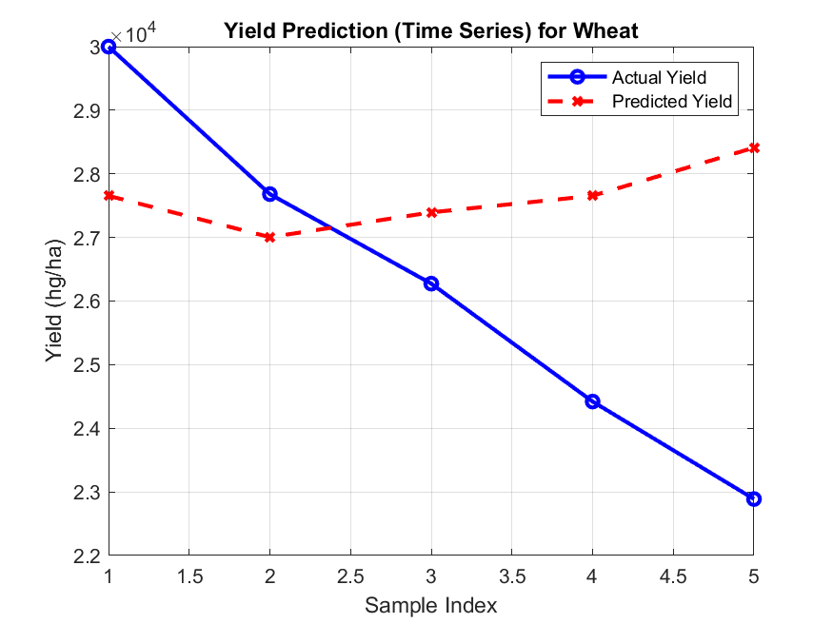
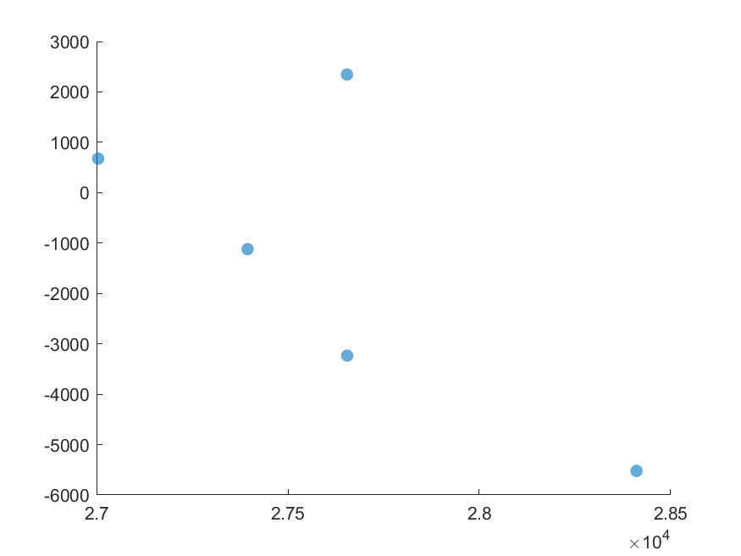
THE FOLLOWING ARE THE MATLAB PLOTS FROM THE CODES.
TIME SERIES
RESIDUAL PLOT
Y=0 LINE
Y=0 LINE
Group 17

Slide 23
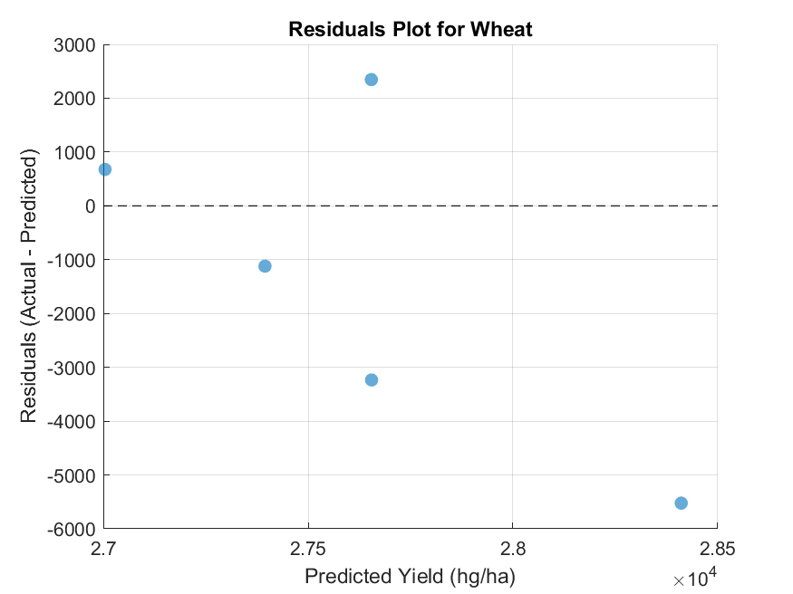
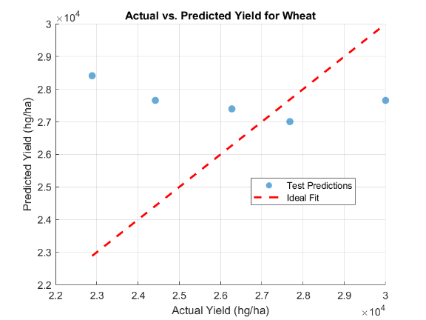
Y=X LINE
Group 17

Slide 24
CHAPTER THREE: CONCLUSION AND LEARNING EXPERIENCE
CONCLUSION
This project successfully implements a complete crop yield estimation system using MATLAB’s object-oriented programming capabilities. By combining abstract and concrete classes, the workflow ensures consistency across different crop models and allows easy extension to other algorithms.
The simulation script demonstrates data loading, preprocessing, training, prediction, and visualization, providing actionable insights for agricultural planning.
Group 17

Slide 25
LEARNING EXPERIENCE
OOP Principles: Learned to apply abstraction, encapsulation, inheritance, and polymorphism in MATLAB.
Data Handling: Practiced cleaning, preprocessing, and filtering large datasets safely.
Modeling & Evaluation: Gained hands-on experience with linear regression, interpreting coefficients, R², residuals, and visual diagnostics.
Simulation & Visualization: Learned to create time-series plots, scatter plots, and residual plots to assess model performance.
Software Design: Understood the importance of modular, reusable, and maintainable code in scientific workflows.
References
Computer programming lecture notes.
MATLAB Documentation. (2025). Object-Oriented Programming (OOP) in MATLAB. MathWorks. Retrieved from https://www.mathworks.com/help/matlab/object-oriented-programming.html
Group 17

Slide 26
Group 17

